Slide 1

Prepared by 24-25J-304
AI Base Alzheimer's Care and Cognitive Support
Research Group Proposal
16 August, 2024

Slide 2





Team Members
Mendis A.R.P.
Sandaruwan W.M.I.M
Bhagya P.S.
Madhusanka J.A. A
IT21228094
IT21231100
IT21225024
IT21215292
Supervisor
Ms. Uthpala Samarakoon
Senior Lecturer
Co-Supervisor
Poorna Panduwawala
Assistant Lecturer

Slide 3


Introduction
Dementia is often regarded as a normal aspect of ageing, but it is a complex and damaging disorder that affects memory, perception, emotions, and cognitive processes. Alzheimer's disease is the primary cause, accounting for 60% to 80% of dementia cases, highlighting the importance of early detection and care. We are creating an innovative smartphone app for dementia sufferers and their carers. This app provides AI-powered support, cognitive exercises, daily diaries, medicine reminders, and memory preservation tools, with the goal of improving the quality of life and care for persons suffering from dementia.

Slide 4





Functions
Innovations in Speech Recognition Technology for Improved Alzheimer's Care and AI Based Support Systems
Monitor Alzheimer's symptoms using cognitive activities.
Emotional Well-being for Alzheimer's Patients through AI-Driven Personalization and Social Connections
Impact of Visual and Auditory Reminders on Adherence to Daily Routines in Alzheimer's Patients

Slide 5




What are the main challenges that Dementia Patients face in these days?
Dementia patients face numerous challenges, particularly as the disease progresses. Some of the main challenges include:
Memory Loss
Difficulty with Communication
Affects thinking, reasoning, and problem-solving abilities
Emotional Distress
Social Isolation

Slide 6

Main Research Problem
Dementia patients in Sri Lanka suffer serious challenges due to a lack of specialised care, limited support systems, and social judgement. The country's healthcare infrastructure struggles to provide continuous cognitive and emotional assistance, resulting in a reduction in these patients' quality of life. Carers frequently lack resources and training, increasing the problem.

Slide 7

Overall Objective
The primary objective is to develop and evaluate an AI-based mobile app that provides comprehensive support for dementia patients in Sri Lanka. The app aims to improve cognitive function, enhance emotional well-being, and ensure better adherence to daily routines by addressing the limitations of the local healthcare system and providing personalized, accessible care solutions.

Slide 8
Technologies
Programming Language
React Native
Spring Boot
Python
Code Editor
VS Code
Android Studio
Database
Firebase
Machine Learning &
AI Technologies
Machine Learning Framework
(TensorFlow or PyTorch)
Reinforcement Learning
Sentiment Analysis
Code Hosting
Git Hub
Security and Privacy
HIPAA Compliance

Slide 9

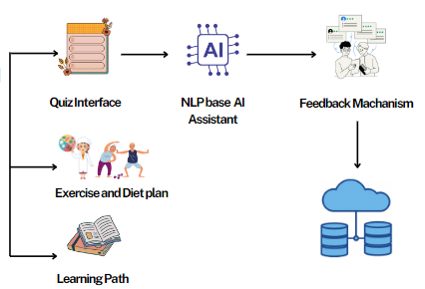
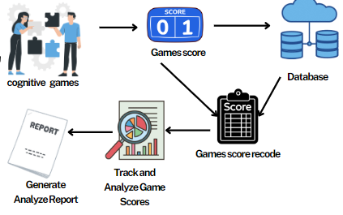

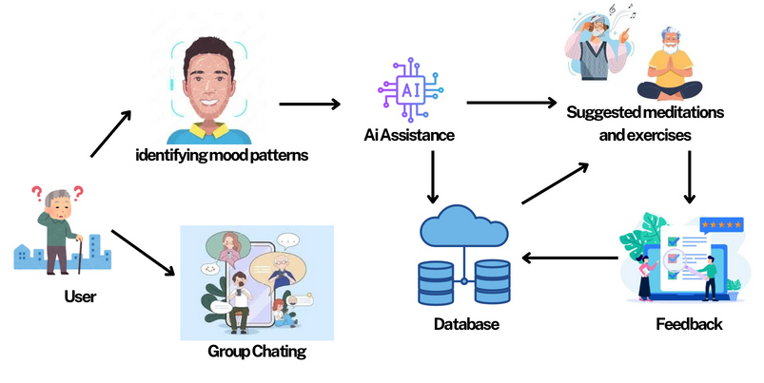
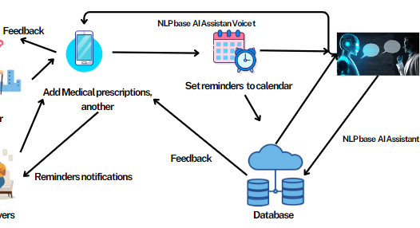

Overall Project Diagram
NLP base AI Assistant
Cognitive Exercise and Score analysis
Emotional Well being
NLP base Daily routine tracker and Reminder

Slide 10


Bhagya P.S.
IT21225024
Innovations in Speech Recognition Technology for Improved Alzheimer's Care and AI Based Support Systems

Slide 11


Research Background
With an aging population globally, the prevalence of Alzheimer's is increasing, therefore making effective care solutions are crucial.
Traditional caregiving methods may not adequately meet the complex needs of Alzheimer's patients, highlighting the need for innovative technological interventions.
AI systems can analyze vast amounts of data, provide predictive analytics, and personalize care, making them valuable in managing chronic conditions like Alzheimer's.
Speech recognition technology, powered by AI, can play a significant role in providing interactive and responsive care to Alzheimer's patients.
The integration of enhanced speech recognition and AI-based predictive analytics presents a novel approach to Alzheimer's care.
The proposed system not only aids in managing symptoms but also supports caregivers by providing actionable insights and recommendations based on real-time data.

Slide 12

Research Questions
01
02
03
04
Gap in Real-Time Feedback and Adaptive Care Mechanisms....
Increasing Need for Personalized Alzheimer's Care..
Limitations in Current Speech Recognition Technology for Healthcare....
Lack of Integrated AI Solutions for Comprehensive Care.....

Slide 13
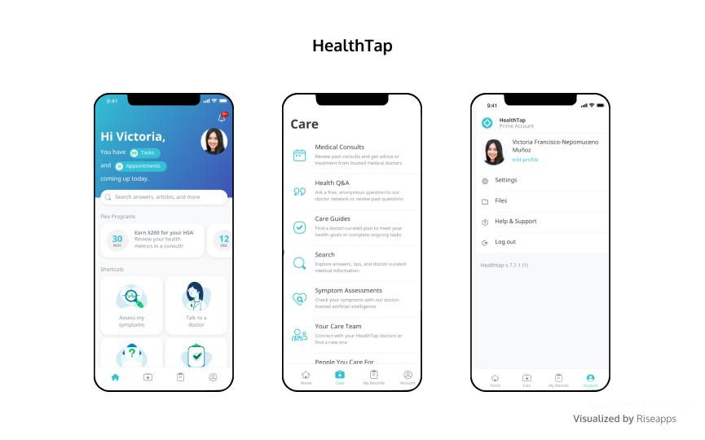
Objective
Special Objective
To develop an AI-powered support system that integrates advanced speech recognition technology, predictive analytics, and personalized care features to improve the quality of life for Alzheimer's patients.

Slide 14
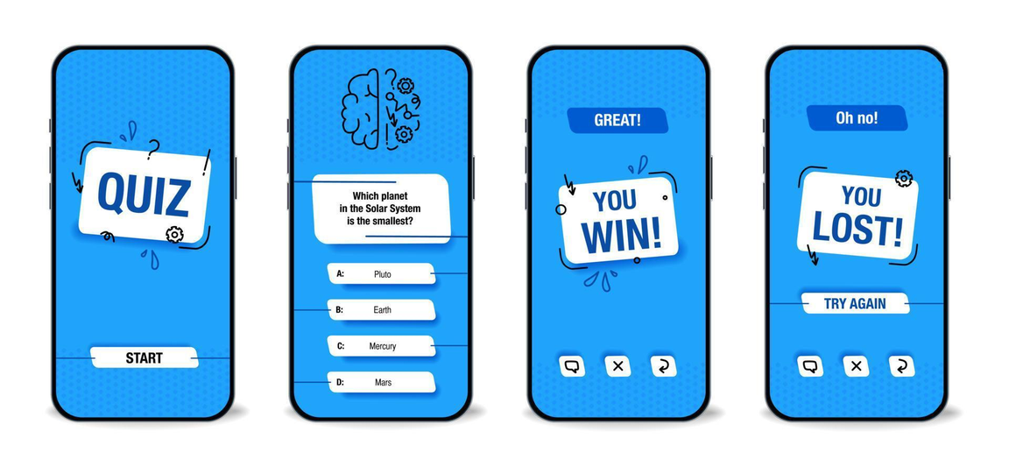
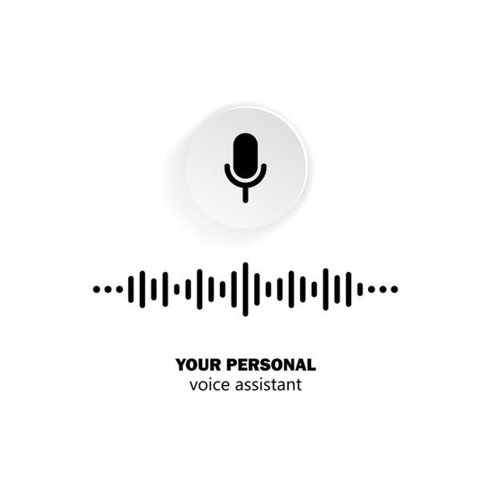

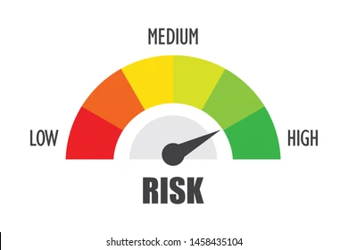


Develop a User-Friendly Quiz Interface
Enhance Speech Recognition Capabilities
Implement Feedback Mechanism
Sub Objectives
Integrate Health Risk Identification
Design a Learning Path
Develop a Physical Exercise and Dietary Interface

Slide 15
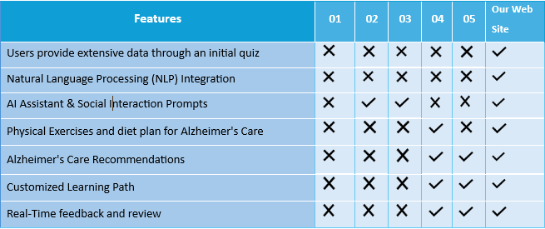
Research Gap

Slide 16
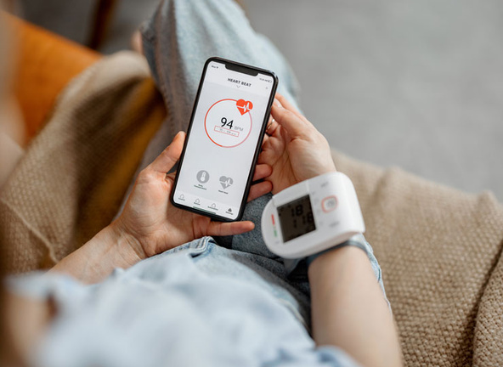




Methodology
System Architecture Diagram
Requirements
Technologies

Slide 17
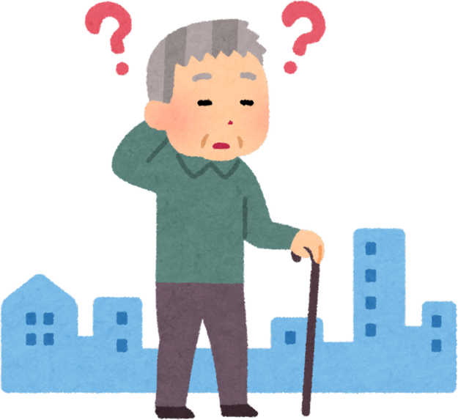
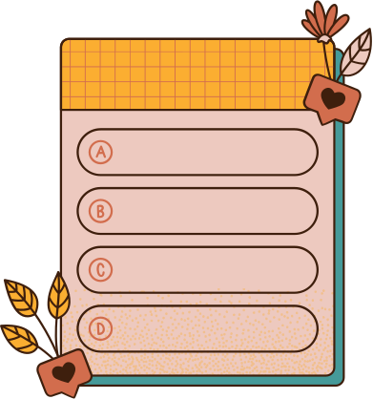



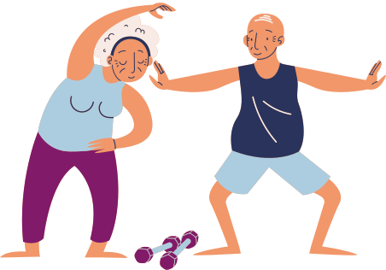


System Architecture Diagram
User
Quiz Interface
NLP base AI Assistant
Feedback Machanism
Exercise and Diet plan
Learning Path

Slide 18
Requirements
User-Friendly Quiz Interface.
NLP Processing.
Feedback Mechanism.
Exercise and Dietary Interface.
Health Risk Identification Alert.
Learning Path
Usability.
Performance.
Scalability.
Security.
Reliability.
Compliance
Functional
Requirement
Non-Functional
Requirement
For Patient.
For Caregivers.
Hardware.
Software.
Development Tools.
Personal
Requirement
System
Requirement

Slide 19
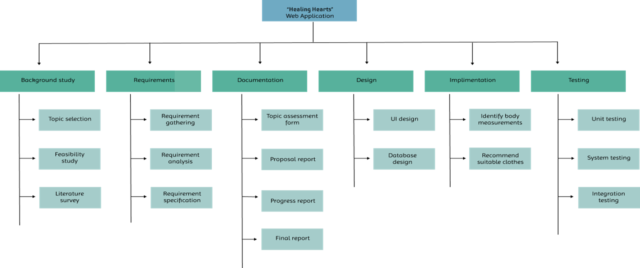
Work Breakdown Chart
Multi-Sensory Cognitive Training
Texture and Sound Matching
Quiz Interface
Exercise Diet and Learning path Interface
Feedback Mechanism

Slide 20
Technology
Programming Language
React Native
Spring Boot
Python
Code Editor
VS Code
Android Studio
Database
Firebase
Pinecone
Machine Learning &
AI Technologies
Machine Learning Framework
(TensorFlow or PyTorch)
Reinforcement Learning
Code Hosting
Git Hub
Generative AI framework
Lama In

Slide 21
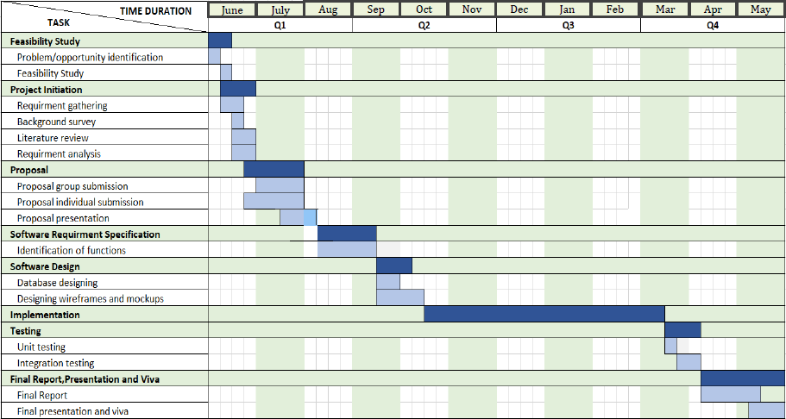
Gannt Chart References

Slide 22
References
Mobile App
DementiaCare - https://play.google.com/store/apps/details?id=app.dementiacare
Release on – 20/11/2023
2. Memory Master - https://play.google.com/store/apps/detailsid=com.memorymaster.memorymaster
Release on – 18/03/2024
Research Paper
A Review of AI Based Medical Assistant Chatbot
Authors: Chetan Bulla, Chinmay Parushetti, Akshata Teli, Samiksha Aski, Sachin Koppad
2. The Companion Chatbot for Dementia Patients
Authors: Varshini M P, Surabhi S, Keerthan Kumar T G
3. An Artificial Intelligence based Approach to Alzheimer’s Disease Patients and Caregivers
Authors: Zainab Khan, Amirita Dewani , Hira Mustafa, Veena Kumari, Memoona Sami, Sania Bhatti

Slide 23

Mendis A.R.P.
IT21228094
Monitor Alzheimer's symptoms using cognitive activities.

Slide 24

Alzheimer's disease is a growing concern worldwide, requiring innovative care solutions to manage the increasing patient population.
Cognitive games serve as tools for tracking cognitive decline, allowing for the creation of personalized care plans based on individual performance.
Analyzing game scores and assessments through big data analytics provides valuable insights into cognitive trends and disease progression.
Combining cognitive training, regular assessments, and communication with healthcare professionals creates a holistic care approach for Alzheimer's patients.
The study aims to develop an Alzheimer's care support system that leverages cognitive games, data analysis, and professional interaction to improve patient care.
Research Background

Slide 25

Research Questions
01
02
03
04
What are the challenges in implementing technology-assisted care devices for the elderly?
How can cognitive games' accuracy for real-time monitoring of Alzheimer's be evaluated effectively?
What strategies and challenges arise in integrating data from cognitive games, assessments, and patient interactions?
How can personalized care plans be optimized using patient performance data for Alzheimer's care?

Slide 26
Objective
Special Objective
Design and test an integrated Alzheimer's care support system, which will be powered by the use of cognitive games, data analysis, and professional communication in monitoring cognitive decline, allowing for efficient, personally-tailored care.

Slide 27

Personalized Cognitive Progress Analysis
Cognitive Game Assessment
Sub Objectives
Analysis of Game Performance Scores

Slide 28
Research Gap
Feature | Research 01 | Research 02 | Research 03 | Proposed System
Standardization issues in scoring (Clock-Drawing Test). | ✔ | ✔ | ✖ | ✔
Correlation of cube, piramid copying with treatment-specific outcomes. | | ✖ | ✖ | ✖ | ✔
Data over time on test results for tracking disease progression. Copy | ✔ | ✖ | ✖ | ✔
Analysis of Game Performance Scores | ✖ | ✖ | ✖ | ✔
Personalized Cognitive Progress Analysis | ✖ | ✖ | ✖ | ✔

Slide 29
Methodology
System Architecture Diagram
Requirements
Technologies

Slide 30


System Architecture Diagram
Games score
Database
cognitive games
Games score recode
User
Track and Analyze Game Scores
Generate Analyze Report

Slide 31
Requirements
Cognitive Game Platform
Game ScoreTracking System
User Interface
Data Analysis
Monthly Reports
Usability.
Performance.
Scalability.
Security.
Reliability.
Compliance
Functional
Requirement
Non-Functional
Requirement
For Patient.
For Caregivers.
Hardware.
Software.
Development Tools.
Personal
Requirement
System
Requirement

Slide 32
Work Breakdown Chart
Multi-Sensory Cognitive Training
Multi-Sensory Cognitive Training Games
Games score recode
Track and Analyze Game Scores
Generate Analyze Report

Slide 33
Technology
Programming Language
React Native
Spring Boot
Python
Code Editor
VS Code
Android Studio
Database
Firebase
Pinecone
Machine Learning &
AI Technologies
Machine Learning Framework
(TensorFlow or PyTorch)
Reinforcement Learning
Code Hosting
Git Hub
Generative AI framework
Lama In

Slide 34
Gannt Chart References

Slide 35
References
Research Paper
Research 01: Artificial Intelligence and Technology Collaboratories: Innovating aging research and Alzheimer’s care
Authors: Peter Abadir, Esther Oh, Rama Chellappa, Niteesh Choudhry, George Demiris, Deepak Ganesan, Jason Karlawish, Benjamin Marlin, Rose M. Li, Najim Dehak, Alicia Arbaje, Mathias Unberath, Thomas Cudjoe, Christopher Chute, Jason H. Moore, Phillip Phan, QuincySamus, Nancy L. Schoenborn, Alexis Battle, Jeremy D. Walston
https://alz-journals.onlinelibrary.wiley.com/doi/full/10.1002/alz.13710
2. Development of mobile compatible software for cognitive–communication disorder in individuals with Alzheimer's disease
Authors: Mümüne Merve Parlak, Ayşen Köse, Murat Güç, Özlem Bizpınar Munis
https://onlinelibrary.wiley.com/doi/10.1111/1460-6984.12941
3. Evaluating Elements of the Care Partner Experience in Individuals Who Care for People with Alzheimer’s Disease Across the Severity Spectrum
Authors: Zainab Khan, Amirita Dewani , Hira Mustafa, Veena Kumari, Memoona Sami, Sania Bhatti
https://link.springer.com/article/10.1007/s40120-023-00558-6

Slide 36
Sandaruwan W.M.I.M.
IT21231100
Emotional Well-being for Alzheimer's Patients through AI-Driven Personalization and Social Connections.

Slide 37
Research Background
Alzheimer's patients often experience anxiety, depression, and social withdrawal, requiring focused emotional support.
AI tools track and analyze mood patterns, identifying triggers and providing timely emotional interventions.
AI can tailor guided meditation and relaxation exercises based on real-time mood and feedback, offering personalized care.
Enhanced platforms enable secure for group messaging, helping reduce social isolation.
The research aims to develop an AI-driven system that adapts interventions in real-time based on mood and environmental data.

Slide 38
Research Questions
01
02
03
04
How can personalized interventions improve the emotional well-being of Alzheimer's patients?
What role does AI play in effectively tracking and managing mood patterns in Alzheimer's patients?
How can technology-driven platforms improve social connections and reduce isolation among Alzheimer's patients?
What are the challenges of implementing a real-time, adaptive emotional support system for Alzheimer's care?

Slide 39
Objective
Special Objective
To develop an AI-driven system that provides real-time, personalized emotional support to Alzheimer's patients by integrating mood tracking, adaptive interventions, and enhanced social interaction tools, thereby improving their overall emotional well-being and quality of life.

Slide 40
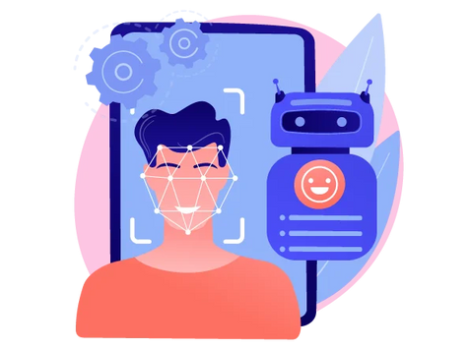


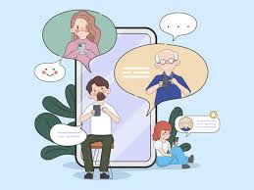
Personalize emotional interventions using AI.
Sub Objectives
Implement guided meditation and relaxation exercises
Caregiver Management Access

Slide 41
Feature | Research 01 | Research 02 | Research 03 | Proposed System
AI-Personalized Mood Tracking | ✔ | ✖ | ✖ | ✔
Use of Personalized Meditations and Exercises | ✖ | ✖ | ✖ | ✔
monitors emotional levels through facial expressions | ✖ | ✖ | ✖ | ✔
Real-Time Emotional Analysis | ✔ | ✔ | ✖ | ✔
Feedback-Driven Content Customization | ✖ | ✖ | ✖ | ✔
Mood Data Analysis | ✔ | ✖ | ✖ | ✔
Research Gap

Slide 42
Methodology
System Architecture Diagram
Requirements
Technologies

Slide 43



System Architecture Diagram
Suggested meditations and exercises
Ai Assistance
identifying mood patterns
User
Database
Feedback
Group Chating

Slide 44
Requirements
Mood Tracking Interface
AI-Based Mood Analysis
Guided Meditations and Exercise Module
Social Interaction Platform
Usability.
Performance.
Scalability.
Security.
Reliability.
Compliance
Functional
Requirement
Non-Functional
Requirement
For Patient.
For Caregivers.
Hardware.
Software.
Development Tools.
Personal
Requirement
System
Requirement

Slide 45
Work Breakdown Chart
Emotional Well-being
Mood Tracking System
Personalized Meditation Module
Emotional Feedback
Social Interaction Platform

Slide 46
Technology
Programming Language
React Native
Spring Boot
Python
Code Editor
VS Code
Android Studio
Database
Firebase
Pinecone
Machine Learning &
AI Technologies
Machine Learning Framework
(TensorFlow or PyTorch)
Reinforcement Learning
Code Hosting
Git Hub
Generative AI framework
Lama In

Slide 47
Gannt Chart References

Slide 48
References
Research Paper
Exploring Intervention Techniques for Alzheimer’s Disease: Conventional Methods and the Role of AI in Advancing Care
Authors: Karthikeyan Subramanian , Faizal Hajamohideen , Vimbi Viswan1, Noushath Shaffi1,Mufti Mahmud
2. AI-Driven Emotional Intelligence for Enhanced Human-Robot Interaction
Authors: Vedika Bengani
3. Social Connection and Compassion : Important predictors of Health and Well-Being
Author: Emma Seppala, Timothy Rossomando, James R. Doty

Slide 49
Madhusanka J.A.A.
IT21215292
Impact of Visual and Auditory Reminders on Adherence to Daily Routines in Alzheimer's Patients

Slide 50
Research Background
Challenge of Routine Adherence: Alzheimer's disease impairs memory and cognitive function, making it difficult for patients to follow daily routines, which are essential for reducing anxiety and confusion.
Role of Visual and Auditory Cues: Visual cues (e.g., images) and auditory reminders (e.g., voice alerts) have been shown to help Alzheimer's patients adhere to routines by aiding memory recall and providing real-time prompts.
Technological Interventions: Existing tools like digital calendars, reminder apps, and wearable devices have demonstrated potential in improving routine adherence among Alzheimer's patients.
Research Aim: The study aims to develop a comprehensive system that integrates visual and auditory reminders, routine management, memory aids, and caregiver support to enhance routine adherence for Alzheimer's patients.

Slide 51
Research Questions
01
02
03
04
How effective are integrated visual and auditory reminders in improving adherence to daily routines among Alzheimer's patients compared to traditional methods
What impact do visual cues (e.g., images and icons) have on memory recall and routine adherence in Alzheimer's patients?
How can a comprehensive system that includes caregiver integration improve the management of daily routines for Alzheimer's patients?
What challenges do Alzheimer's patients and their caregivers face when using assistive technologies, and how can these challenges be mitigated through a user-friendly system?

Slide 52
Objective
Special Objective
To design and develop an innovative, user-friendly system that seamlessly integrates visual and auditory reminders with routine management and caregiver involvement, ultimately enhancing adherence to daily routines and improving the overall quality of life for Alzheimer's patients.

Slide 53
Voice Command Recognition
Sub Objectives
Memory Aid Integration
Enhance social connections

Slide 54
Research Gap
Feature | Research 01 | Research 02 | Research 03 | Proposed System
Visual & Auditory Functionality | ✔ | ✖ | ✖ | ✔
NLP base AI Voice | ✖ | ✖ | ✖ | ✔
Caregiver Management Access | ✖ | ✖ | ✖ | ✔
Real-Time Notification System | ✔ | ✔ | ✖ | ✔
Memory Aid Integration | ✖ | ✖ | ✖ | ✔
Medicine Photo Recognition | ✖ | ✖ | ✖ | ✔
Routine Tracking | ✖ | ✖ | ✔ | ✔

Slide 55
Methodology
Technologies
Requirements
System Architecture Diagram

Slide 56



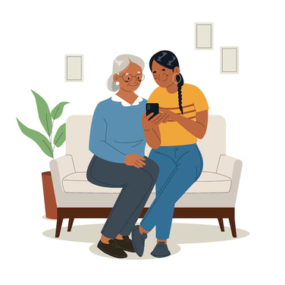
System Architecture Diagram
NLP base AI Assistan Voice t
Feedback
Set reminders to calendar
Add Medical prescriptions,
another
User
NLP base voice Assistant
Feedback
Reminders notifications
caregivers
Database

Slide 57
Requirements
Visual & Auditory Functionality
Routine Tracking
Memory Aid Integration
NLP base AI Voice
Caregiver Management Access
Notification System
Usability.
Performance.
Scalability.
Security.
Reliability.
Compliance
Functional
Requirement
Non-Functional
Requirement
For Patient.
For Caregivers.
Hardware.
Software.
Development Tools.
Personal
Requirement
System
Requirement

Slide 58
Work Breakdown Chart
daily routines
Alzheimer's patients
Daily routines among
Alzheimer's patients
Add Reminders to calendar
Set It calendar and send notifications user & caregivers
NLP base AI Voice

Slide 59
Technology
Programming Language
React Native
Spring Boot
Python
Code Editor
VS Code
Android Studio
Database
Firebase
Pinecone
Machine Learning NLP
Machine Learning Framework
(TensorFlow or PyTorch)
Reinforcement Learning
Code Hosting
Git Hub
Generative AI framework
Lama In

Slide 60
Gannt Chart References

Slide 61
References
Mobile App
Medisafe Medication Reminder
2. MediSafe Pill & Med Reminder
Research Paper
TEACHING CAREGIVERS TO USE MEMORY AIDS WITH PATIENTS WITH DEMENTIA - Michelle S. Bourgeois, Ph.D.
2.Caregivers' experiences of patients with moderate-stage Alzheimer's disease
Authors: Munevver Ozcan
3. Natural language processing to identify social determinants of health in Alzheimer's disease and related
Authors: Wenbo Wu PhD, Kaes J. Holkeboe

Slide 62
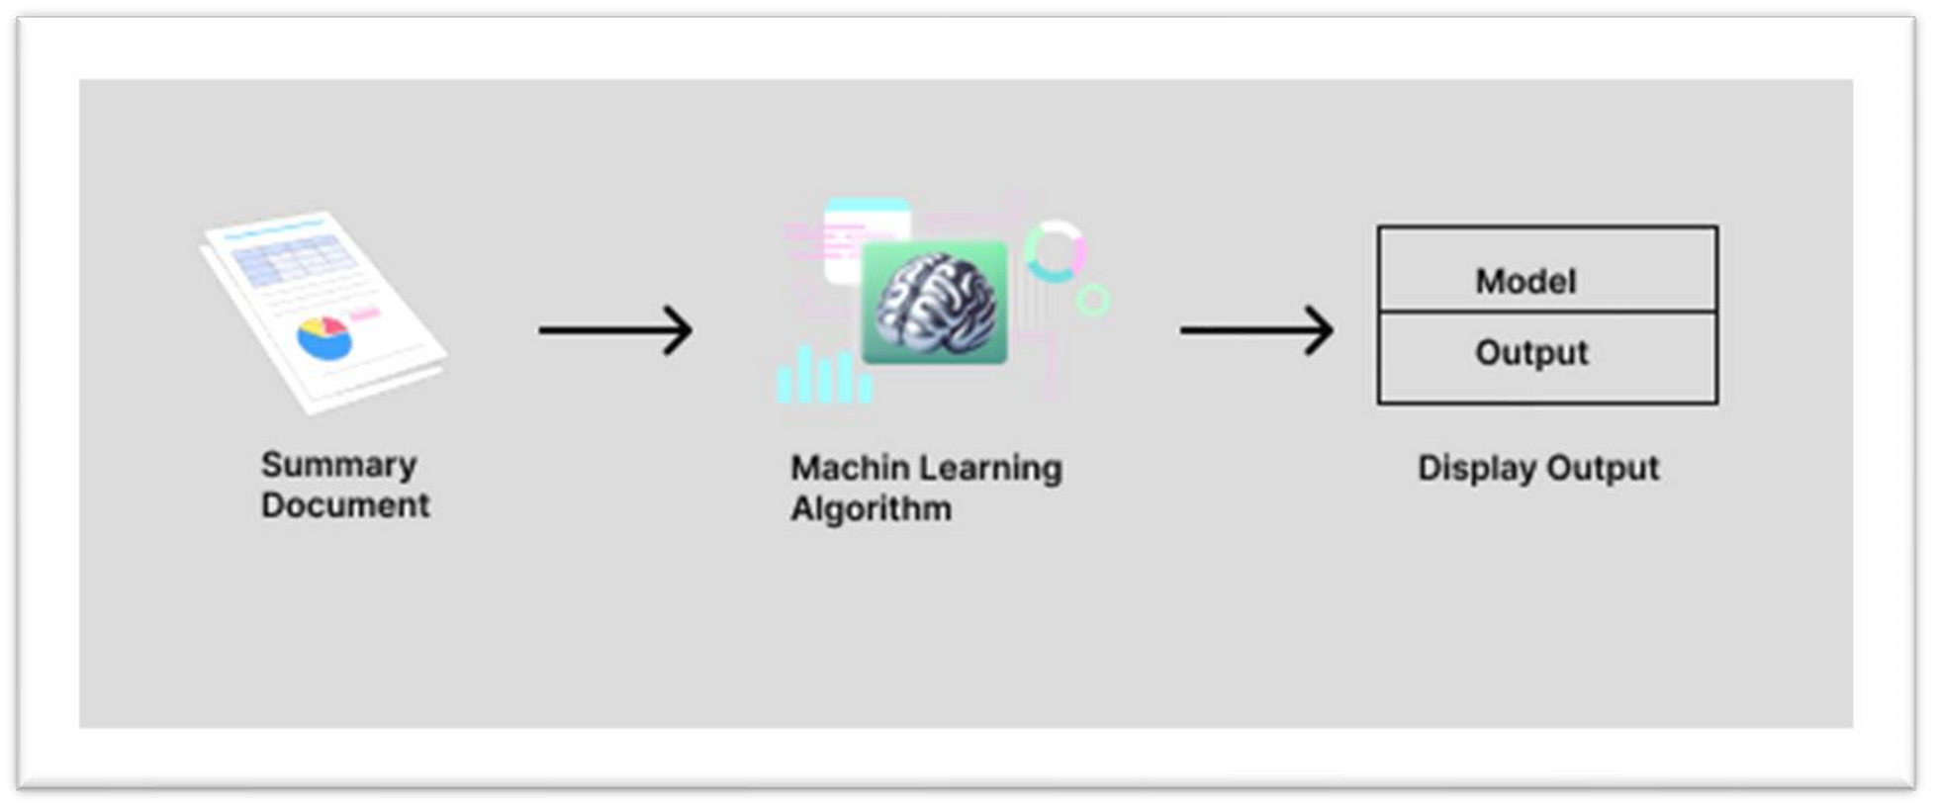
Ai algorithmes

